Slide 1
计算机图形学
Computer Graphics
Lin Lu (吕琳)
Shandong University
http://irc.cs.sdu.edu.cn/~lulin
Research: Modelling and Simulation in Computer Graphics

Slide 2
课程安排
上课：周二 5-6节 （振声苑W301）
实验：周一 7-8节 （N3-待定）
总成绩=40%平时成绩+60%期末成绩
助教：孙炳腾 王忠仁
授课：吕琳（N3-412）Lulin.linda@gmail.com, llu@sdu.edu.cn

Slide 3

教材
《计算机图形学基础教程（第2版）》
（孙家广、胡事民），清华大学出版社
可参考的在线课
主讲人：闫令琪@UCSB
课件：https://sites.cs.ucsb.edu/~lingqi/teaching/games101.html
课程录像：https://www.bilibili.com/video/av90798049

Slide 4
Prerequisites
Good programming skills in C (or C++)
Basic Data Structures
Linked lists
Arrays
Geometry
Simple Linear Algebra

Slide 5
《计算机图形学》课程的重要性
ACM/IEEE CC2001就规定为计算机专业核心课程
CS255{S,W}. Computer Graphics
教育部教学指导委员会制定的CCC2002，也规定为计算机专业16门核心课程之一。
计算机图形学是计算机领域最活跃的研究方向，理论深刻、应用广泛。

Slide 6
《计算机图形学》课程的重要性
计算机图形学是利用计算机研究图形的表示、生成、处理和显示的学科
起源
1950年，第一台图形显示器作为MIT的旋风I号（Whirlwind I）计算机的附件诞生
50年代末期，MIT的林肯实验室在“旋风”计算机上开发SAGE空中防御体系
如果没有图形学，我们在纸带打上孔！

Slide 7
《计算机图形学》课程的重要性
计算机图形学是利用计算机研究图形的表示、生成、处理和显示的学科
旋风一号计算机

Slide 8
Requirements
5 Programming Assignments
0. Get familiar with OpenGL
Line/circle drawing
Rasterization algorithms
Spline Curves
3D modeling, hierarchical transformation and shading
Polygonal mesh processing

Slide 9
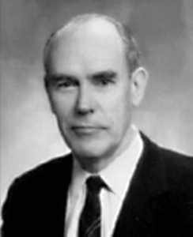
Ivan Sutherland - Father of Computer Graphics
计算机图形学的传承
1962年，MIT林肯实验室的Ivan E. Sutherland在他的博士论文"Sketchpad：一个人机交互通信的图形系统"中首次使用了计算机图形学"Computer Graphics"这个术语，证明了交互计算机图形学是一个可行的、有用的研究领域，从而确定了计算机图形学作为一个崭新的独立科学分支的地位。
Ivan E Sutherland, born 1938, Hartings, Nebraska

Slide 10

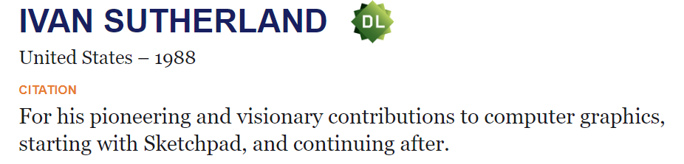
Ivan Sutherland - Father of Computer Graphics
1988年 图灵奖
1998年 IEEE计算机杰出成就奖
1983年 Coons奖

Slide 11
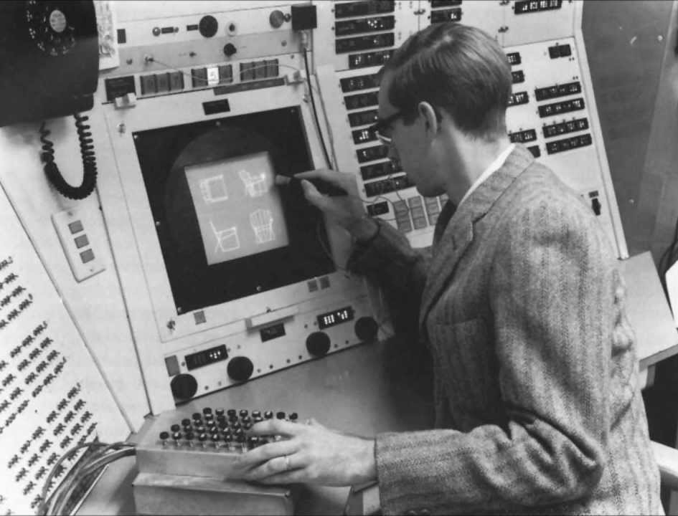

Slide 12
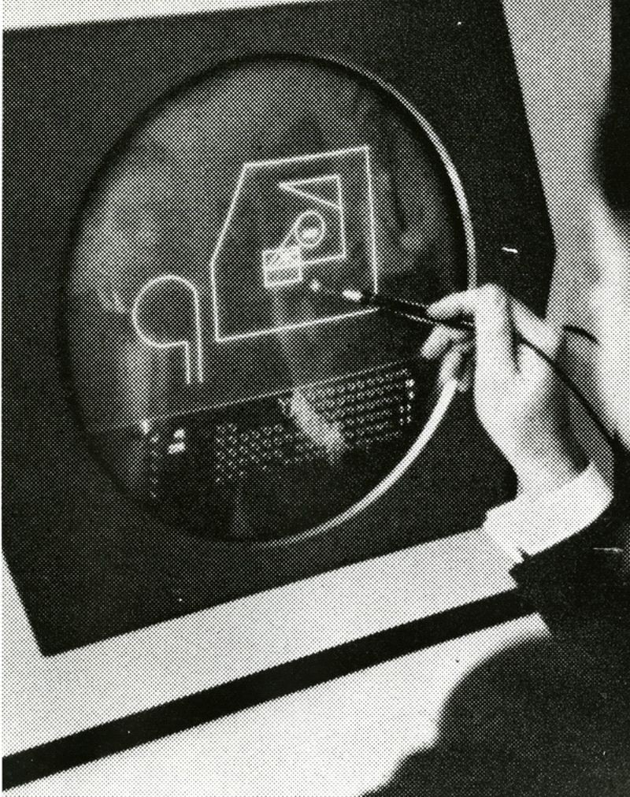

Slide 13
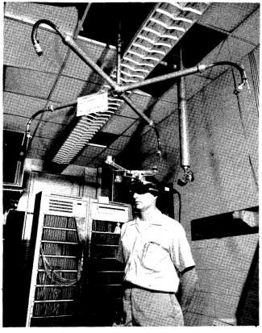
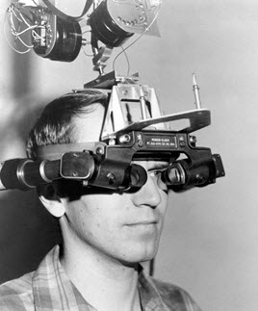
Virtual Reality
In 1966 Sutherland, while an Associate Professor at Harvard, took another huge step towards the future of computing – one that we still haven’t completed today.
The Head-mounted Display worn by Donald L. Vickers, one of Ivan E. Sutherland’s Students at The University of Utah. Photo courtesy of Ivan Sutherland.

Slide 14
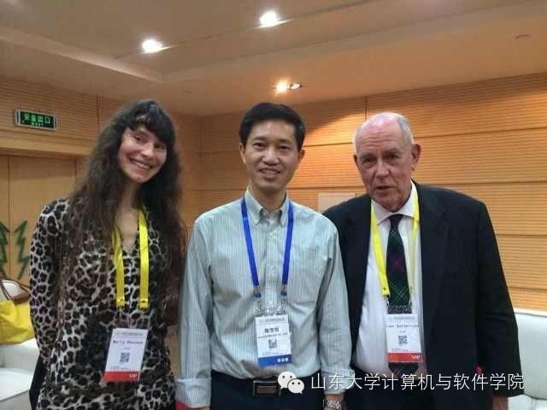
中国计算机大会（CNCC 2014）邀请到Ivan Sutherland教授做特邀报告。山东大学陈宝权教授与几位IT媒体记者对Sutherland教授进行了一个多小时的访谈。
陈宝权教授与Sutherland夫妇
https://mp.weixin.qq.com/s/nBjhfTwNuElmFbs-5P7rVw

Slide 15
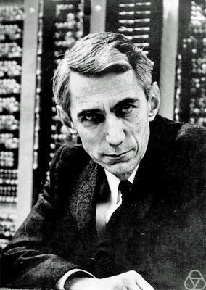
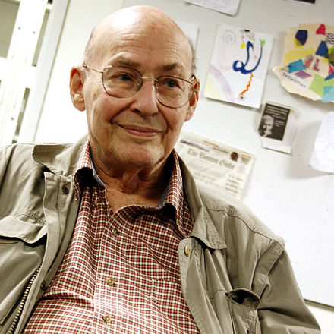
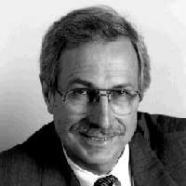
Claude Shannon
Marvin Minsky
Steven Coons
Steven A. Coons Award
The Association for Computing Machinery SIGGRAPH has an award named for Coons. The Steven Anson Coons Award for Outstanding Creative Contributions to Computer Graphics is given in odd-numbered years to an individual to honor that person's lifetime contribution to computer graphics and interactive techniques.
It is considered the field's most prestigious award.

Slide 16
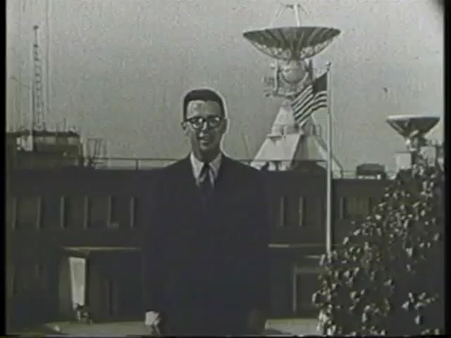

Slide 17
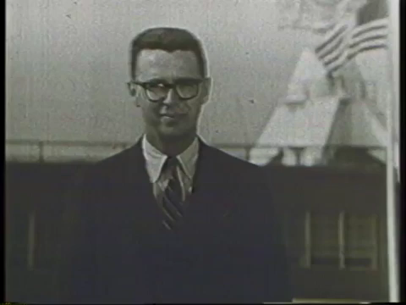

Slide 18
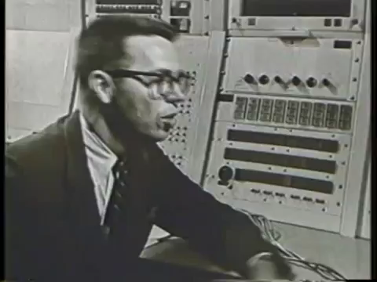

Slide 19
计算机图形学的传承
2003年图灵奖授予Alan Kay
毕业于Utah大学，师从Evan Sutherland
发明面向对象编程和窗口图形用户界面技术
提出PC机的概念
美国工程院院士、
美国艺术与科学院院士
The best way to predict the future is to invent it.
——Alan Kay

Slide 20
计算机图形学的传承
2019 年图灵奖授予 Edwin E. Catmull 和
Patrick M. Hanrahan
Edwin E. Catmull 毕业于 Utah，师从Evan Sutherland
Hanrahan 和 Catmull 研发了RenderMan（图形学+软件）
3D计算机图形学，对电影制作和计算机生成图像 (CGI）等应用产生革命性影响

Slide 21
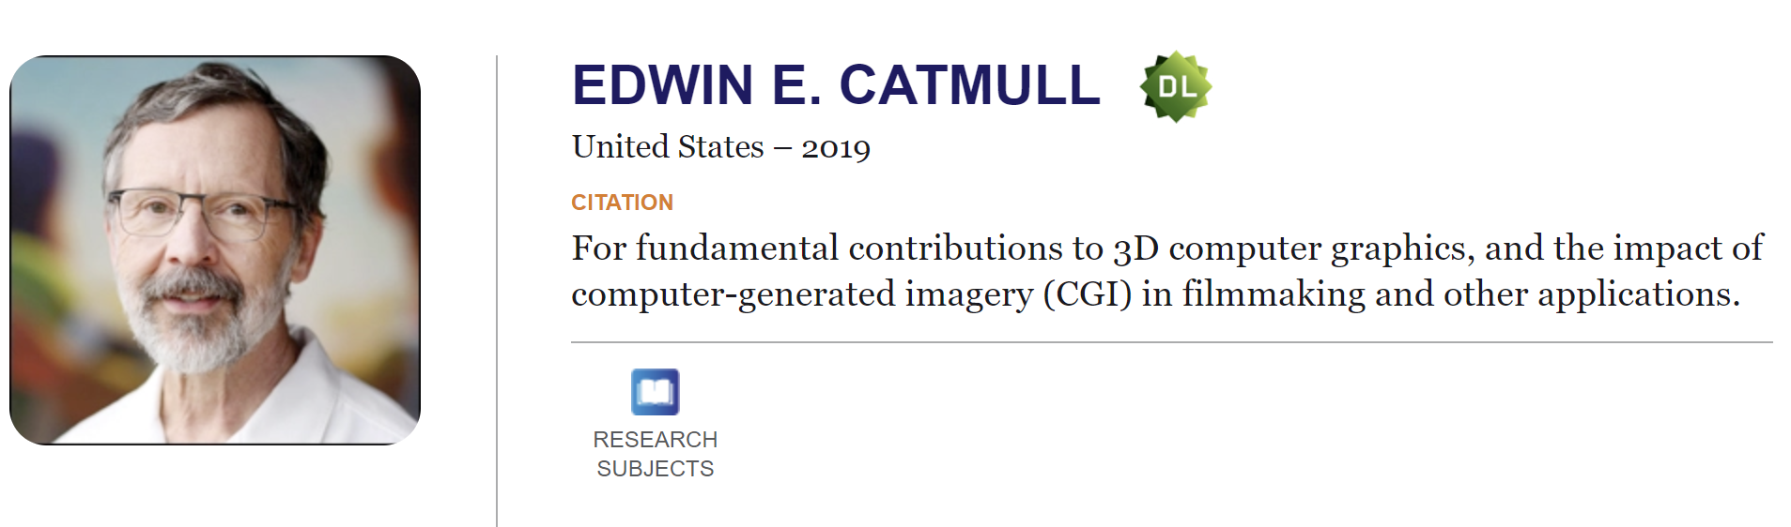
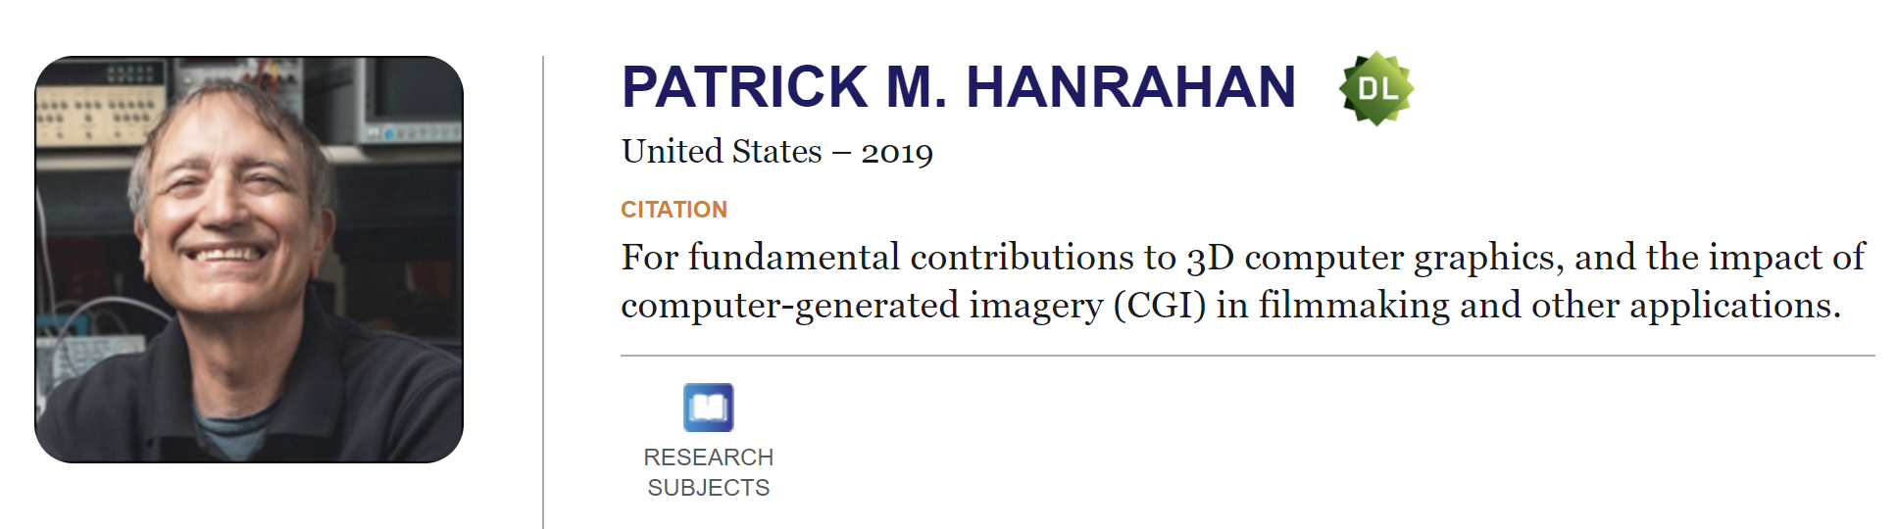
ACM A.M. TURING AWARD 2019

Slide 22
Edwin Catmull –
Known for Texture mapping, Catmull–Rom spline, Catmull–Clark subdivision surface
co-founder of Pixar, President of Walt Disney Animation Studios
Pat Hanrahan –
Known for simulating subsurface scattering of light in translucent materials, etc.
founding employee at Pixar, co-founder of Tableau Software

Slide 23
《计算机图形学》课程的重要性
计算机图形学改变了计算机的形态，使得计算机/智能终端成为人类最亲密的伙伴:
延拓了人类的感知能力、增强人类的信息处理能力。智能手机、iPad、…
图形学&CAD，互为基础、互为应用；图形学是计算机科学与工程应用之间的桥梁。
信息技术的发展，未来扮演重要角色的虚拟现实、工业设计软件、数字孪生、智慧城市、元宇宙等，都基于图形学。
图形的表示、生成、处理和显示，是信息技术的重要基础

Slide 24

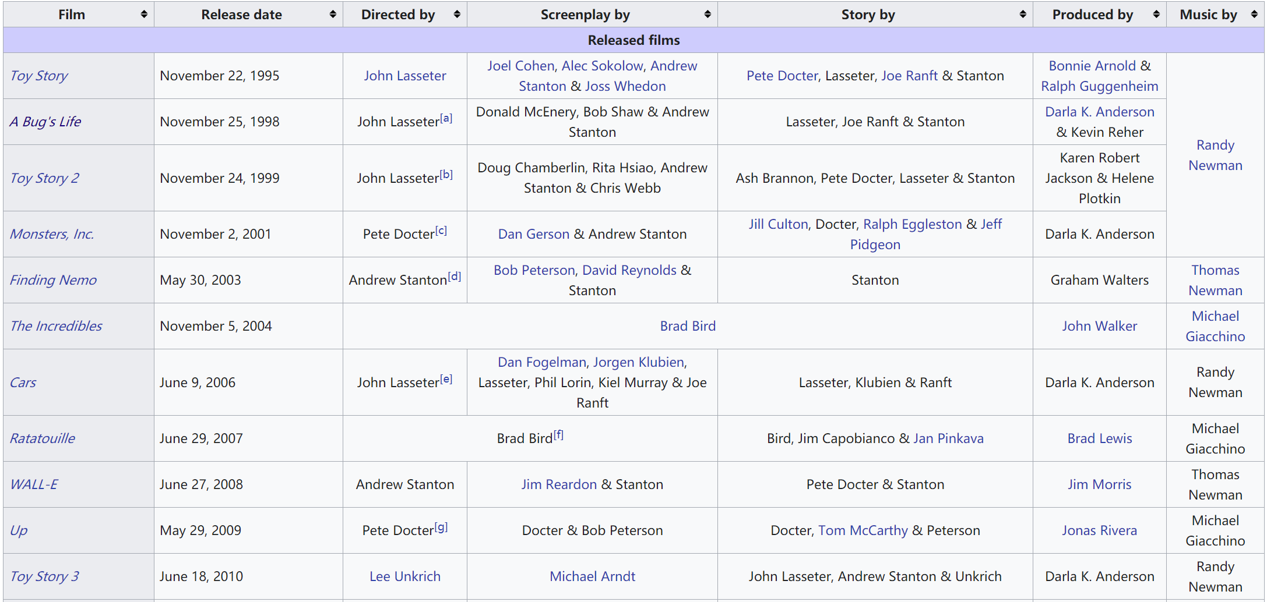
List of Pixar films

Slide 25
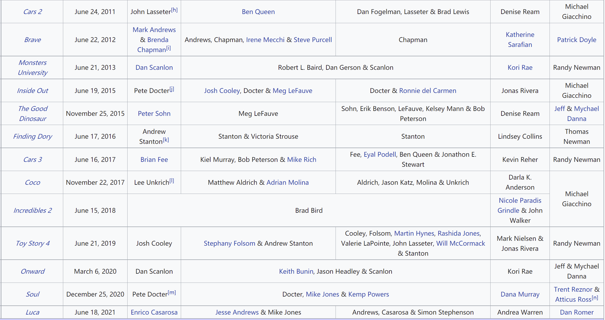
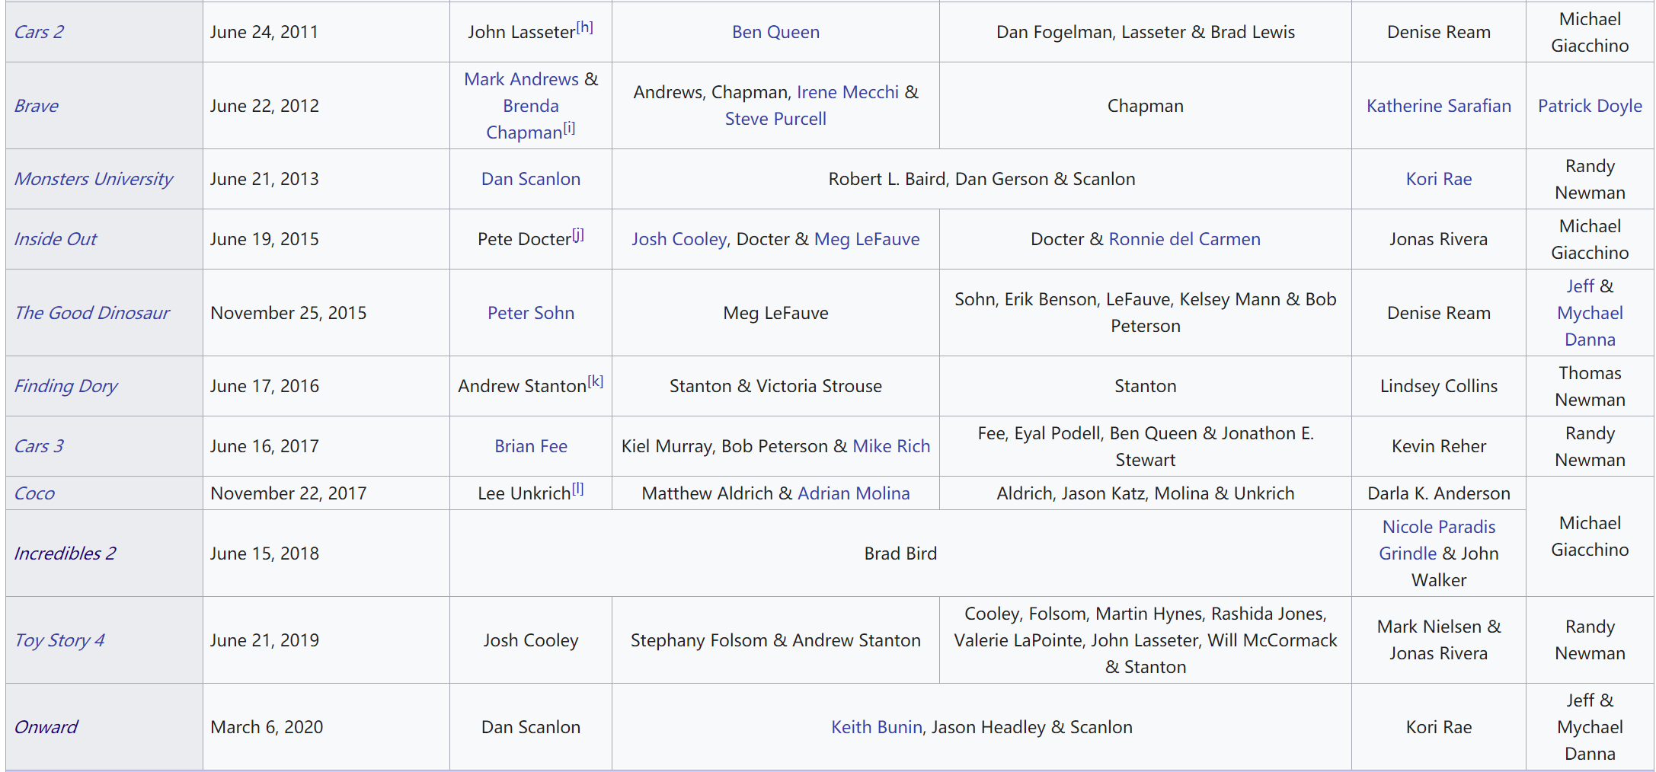
List of Pixar films

Slide 26

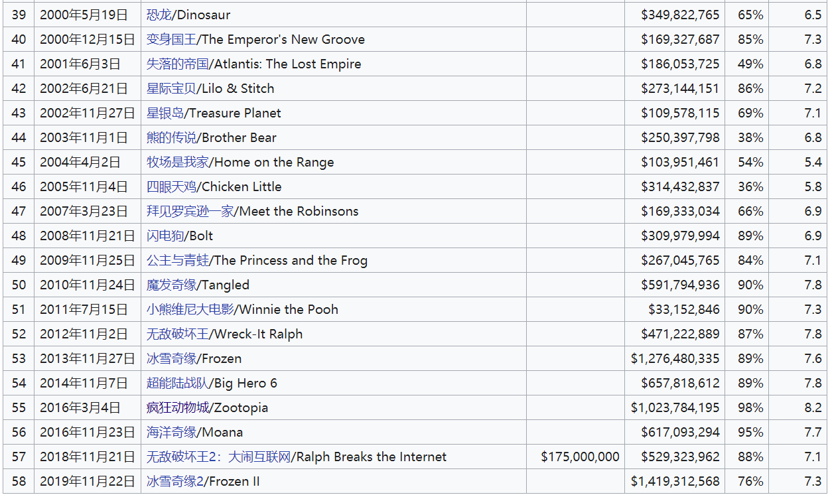
List of Walt Disney Animation Studios Films

Slide 27


Zootopia (2016)
Frozen 2 (2019)

Slide 28

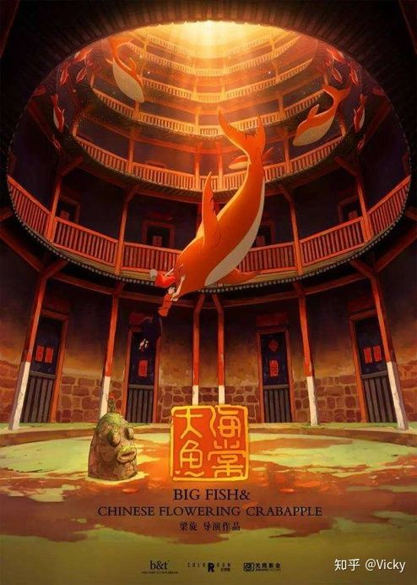


优秀国产动画电影

Slide 29
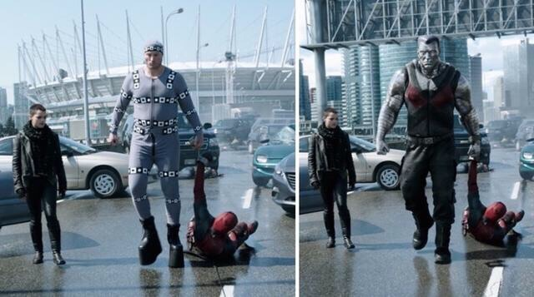
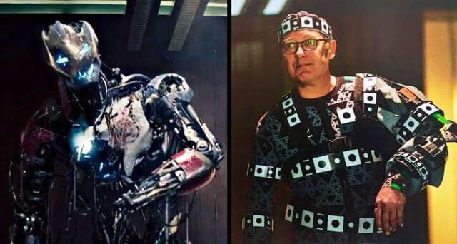
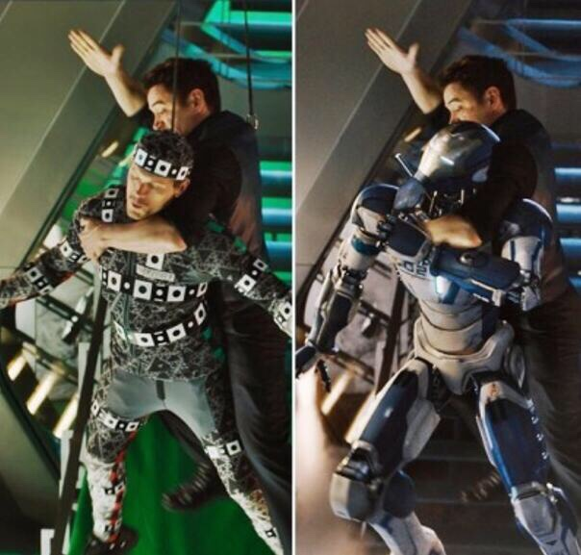
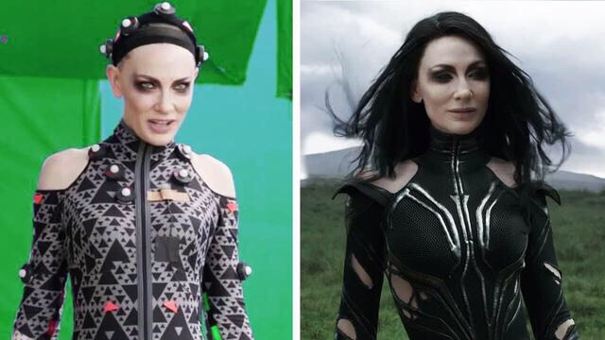
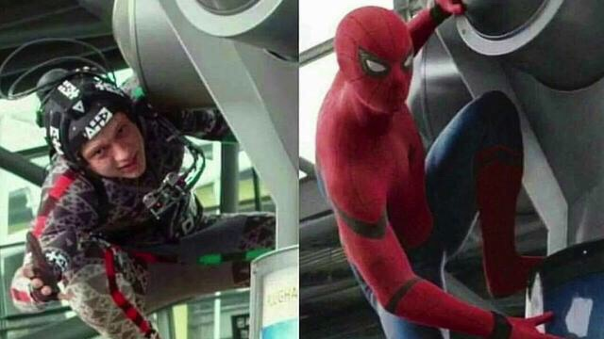

Slide 30
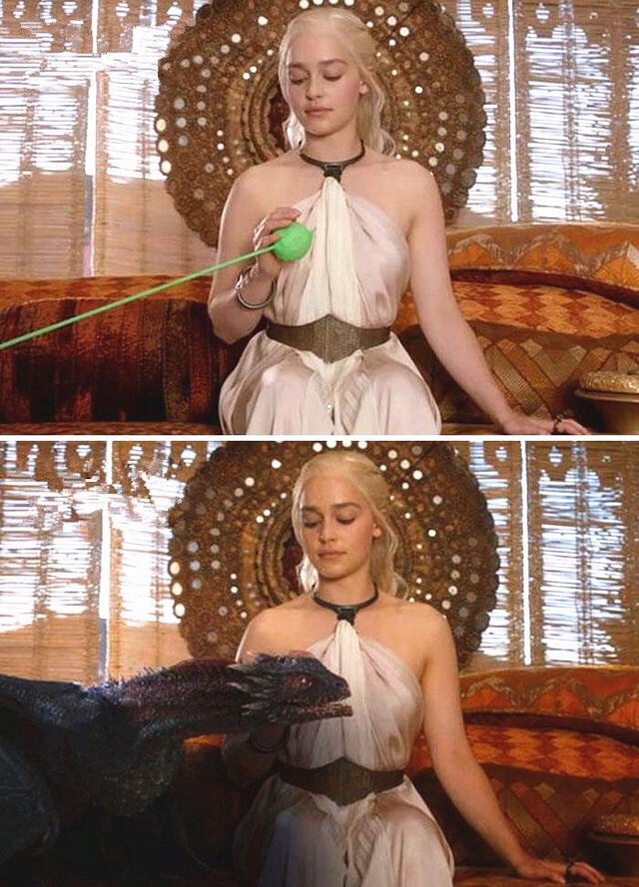
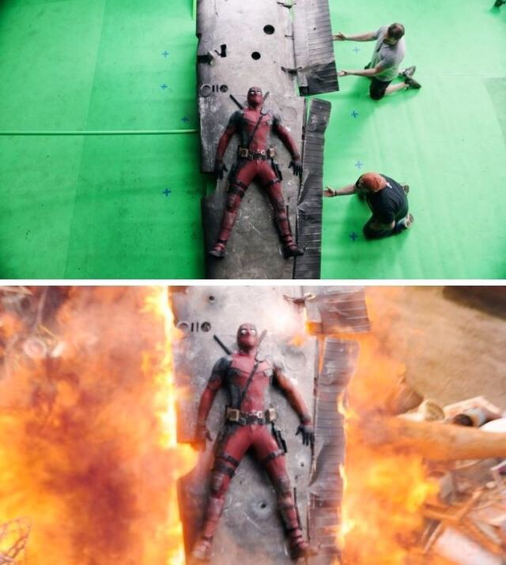
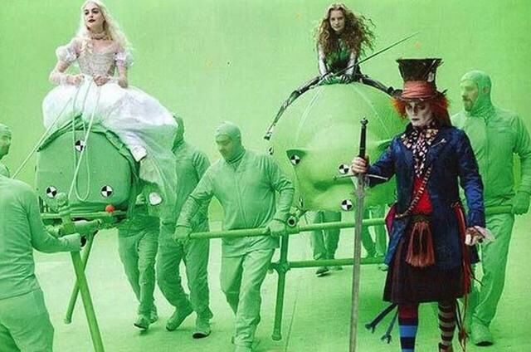
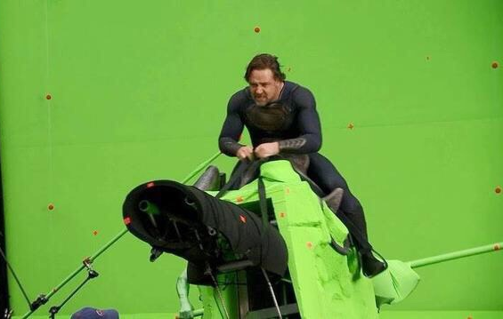
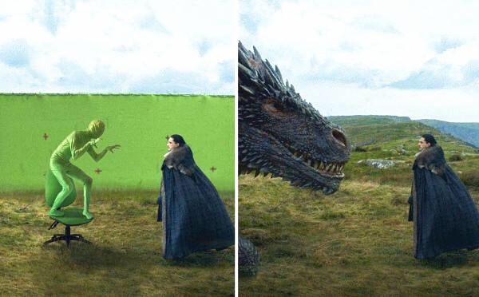

Slide 31
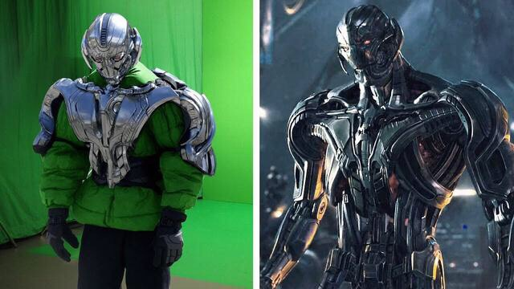
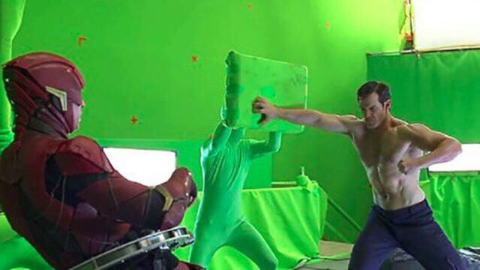

Slide 32
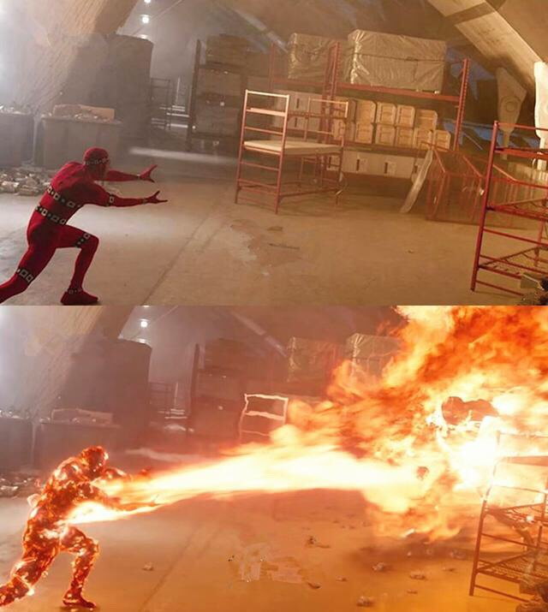
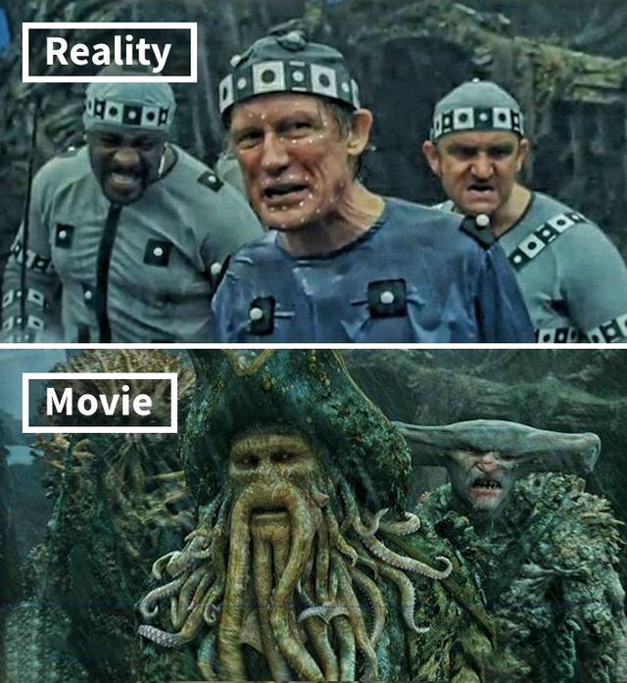

Slide 33
What is Computer Graphics?
Computer graphics is a sub-field of computer science which studies methods for digitally synthesizing and manipulating visual content.
Although the term often refers to the study of three-dimensional computer graphics, it also encompasses two-dimensional graphics and image processing.
--Wikipedia

Slide 34
More Applications on Computer Graphics?
Besides movies and animations.

Slide 35
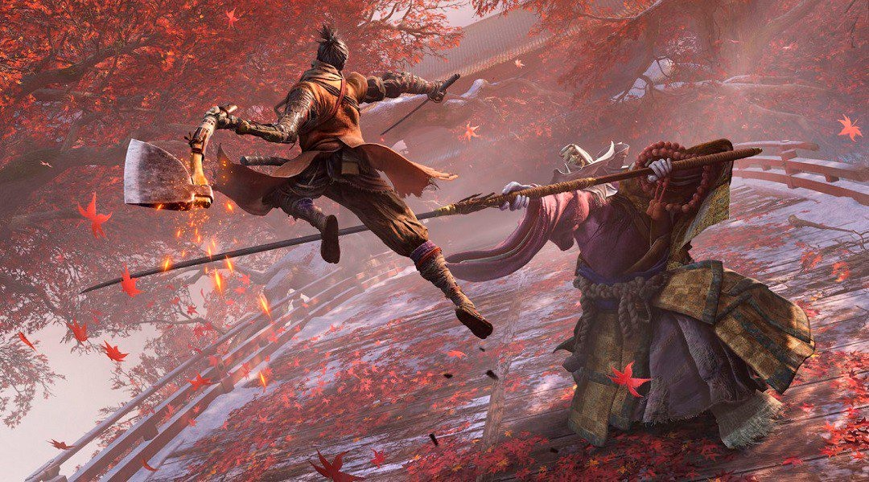
Video Games
Sekiro: Shadows Die twice (2019 Game of the Year)
GAMES101 9 Lingqi Yan, UC Santa Barbara

Slide 36

Video Games
GAMES101
Borderlan¹d⁰s 3 (2019)
Lingqi Yan, UC Santa Barbara

Slide 37
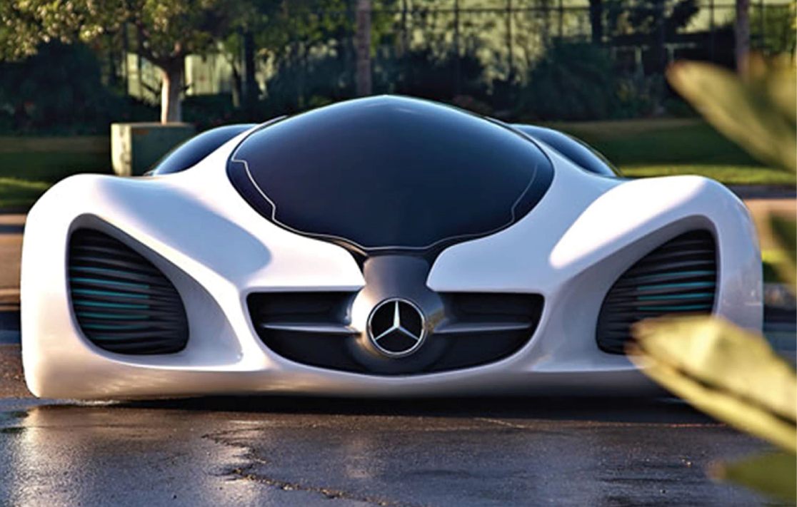
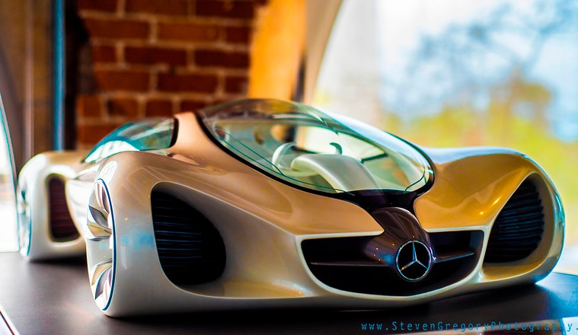
Design
CG
Photo
Autodesk Gallary

Slide 38

Design
Ikea - 75% of catalog is rendered imagery

Slide 39
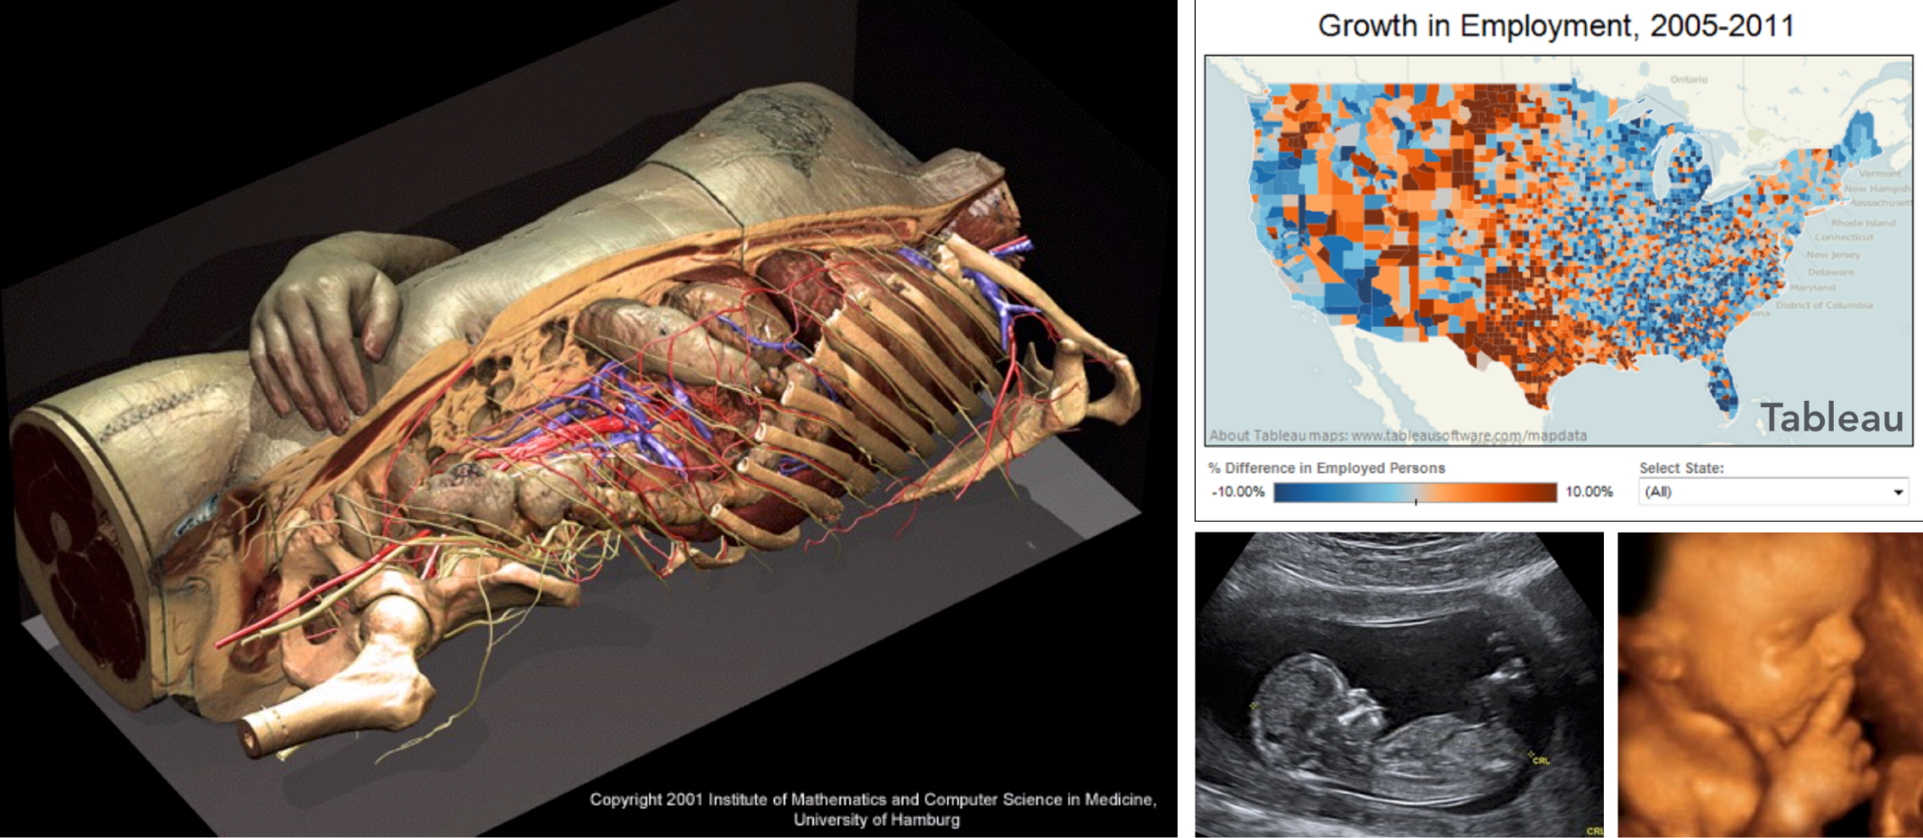
Visualization
Science, engineering, medicine, journalism, etc.

Slide 40
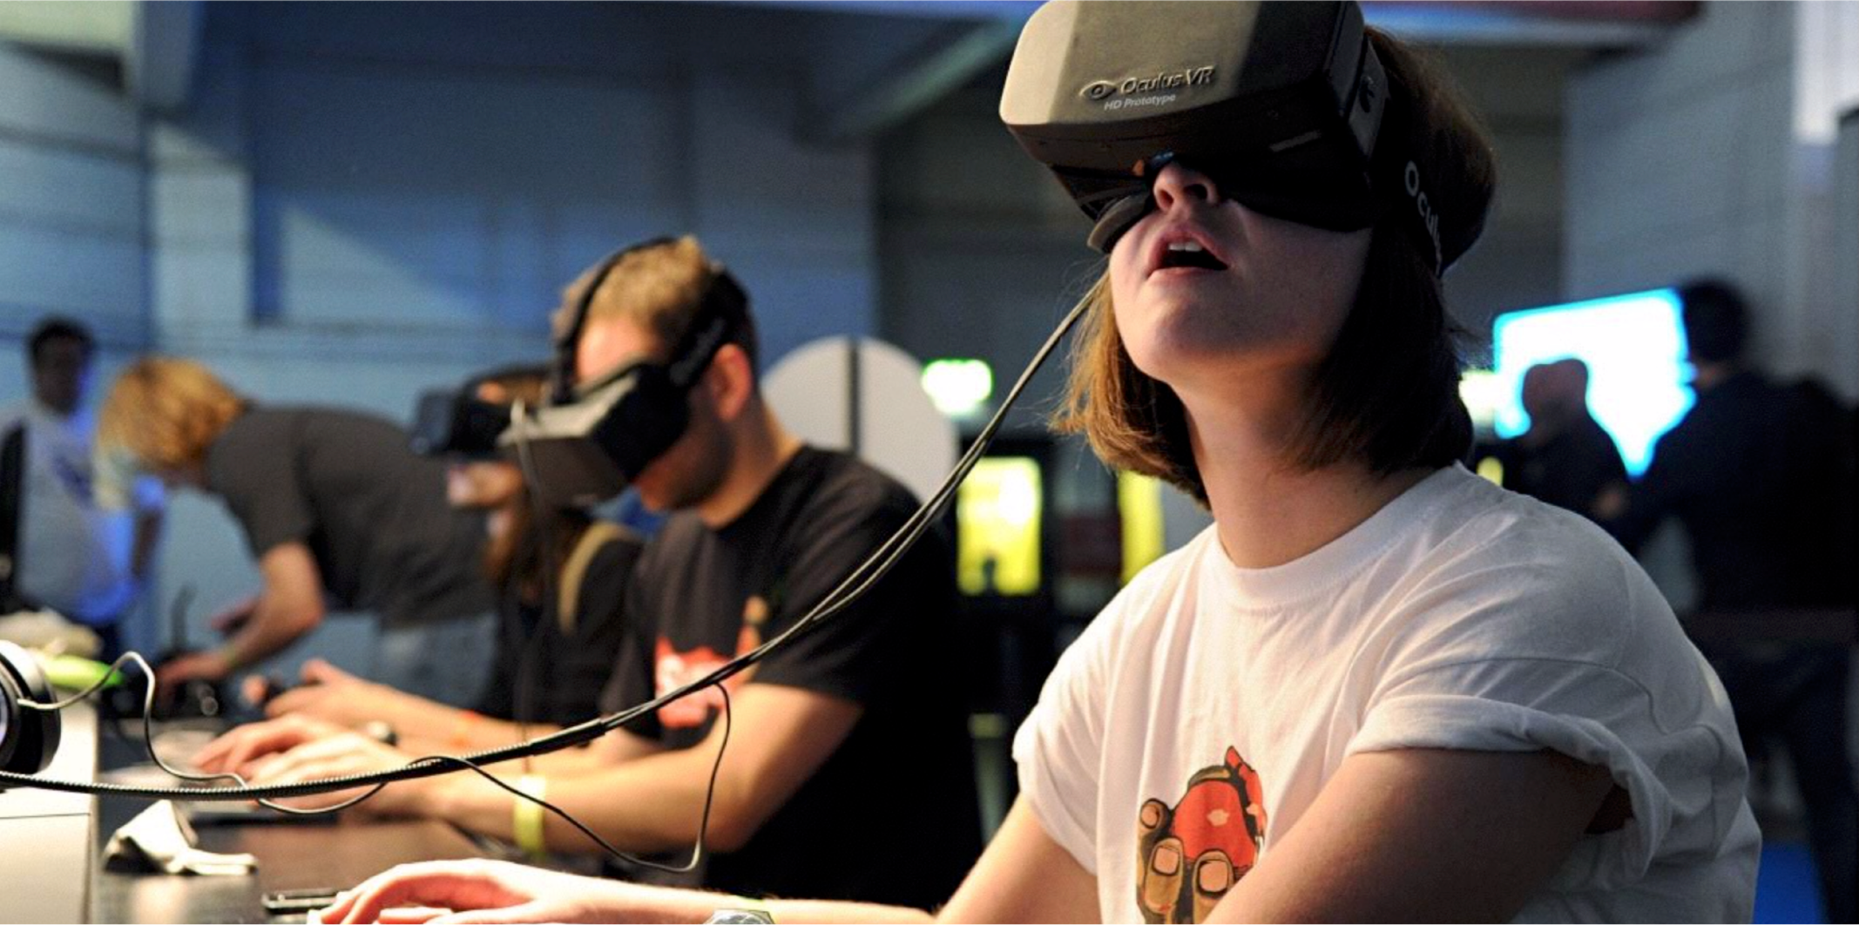
Virtual Reality
Oculus VR

Slide 41
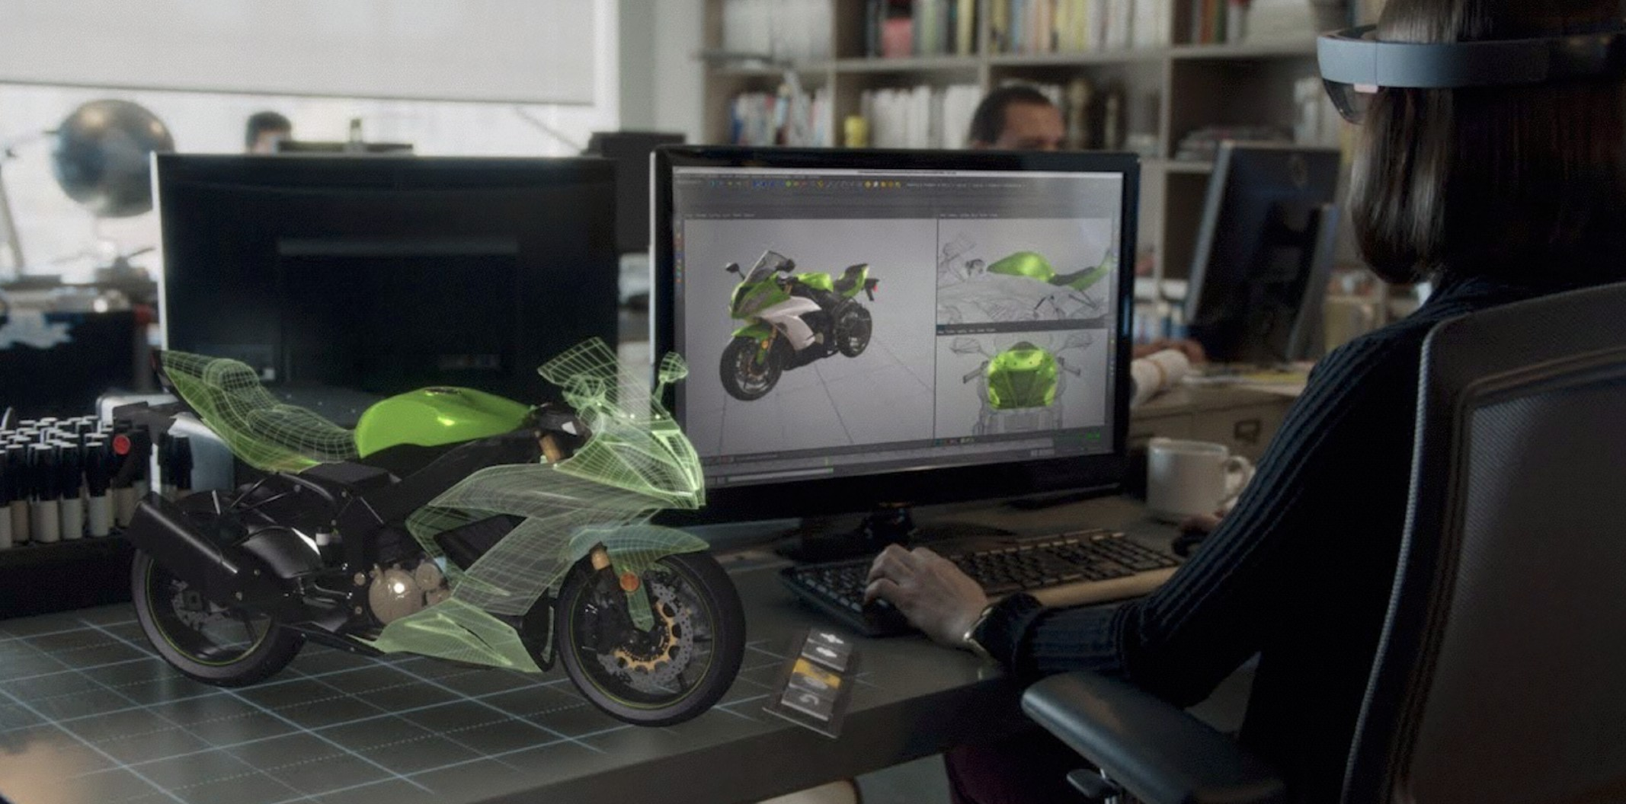
Augmented Reality
Microsoft Hololens

Slide 42
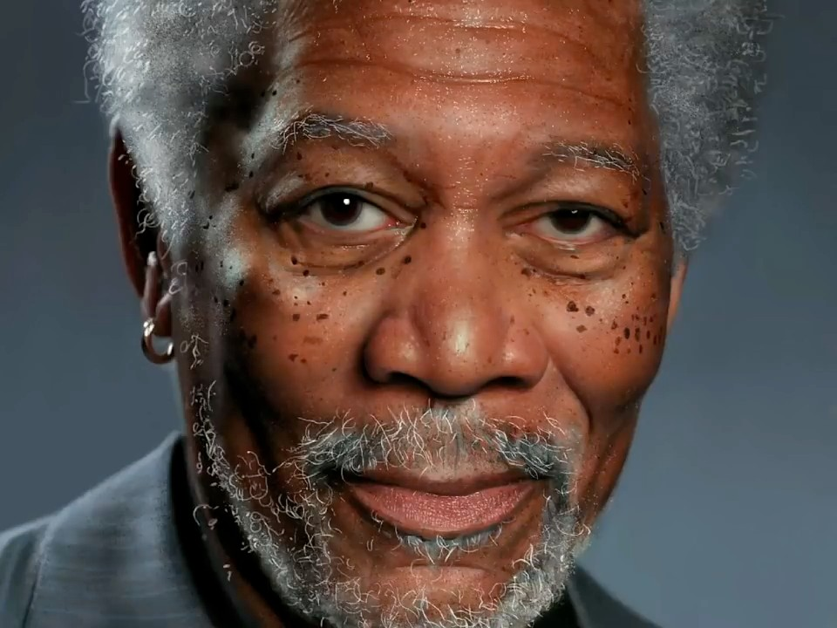
Digital Illustration
https://www.youtube.com/watch?v=uEdRLlqdgA4

Slide 43
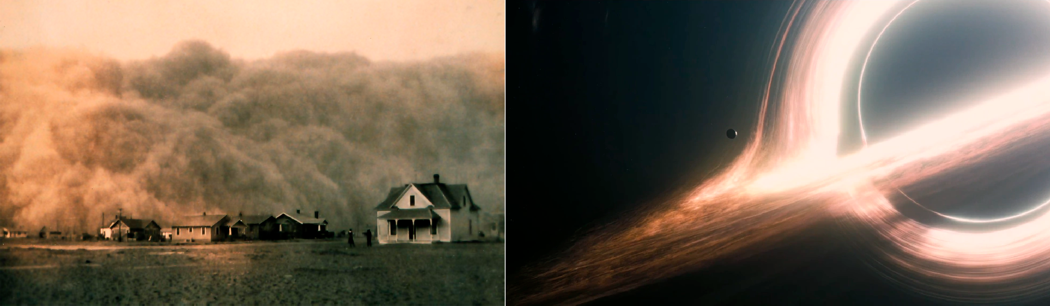
Simulation
The Dust Bowl phenomena
Black hole from Interstellar

Slide 44
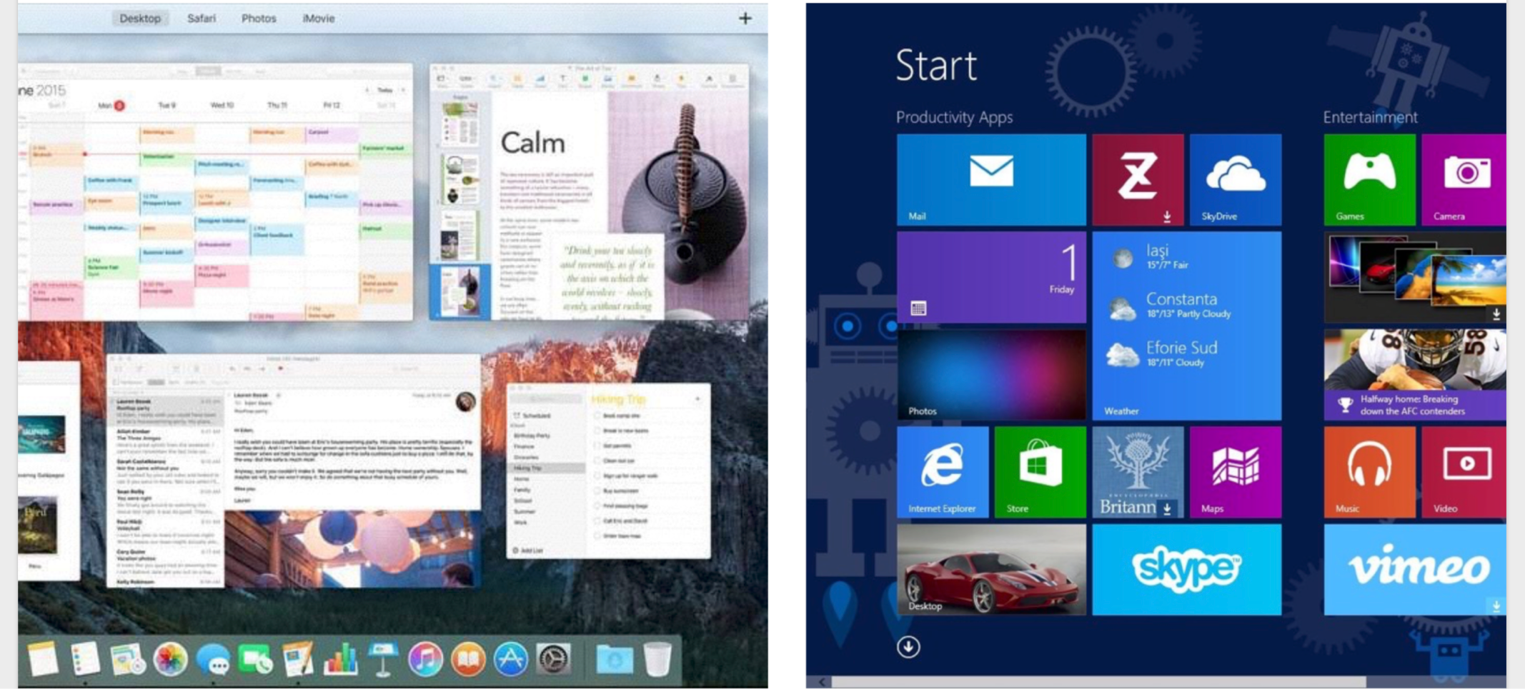
Graphical User Interfaces

Slide 45
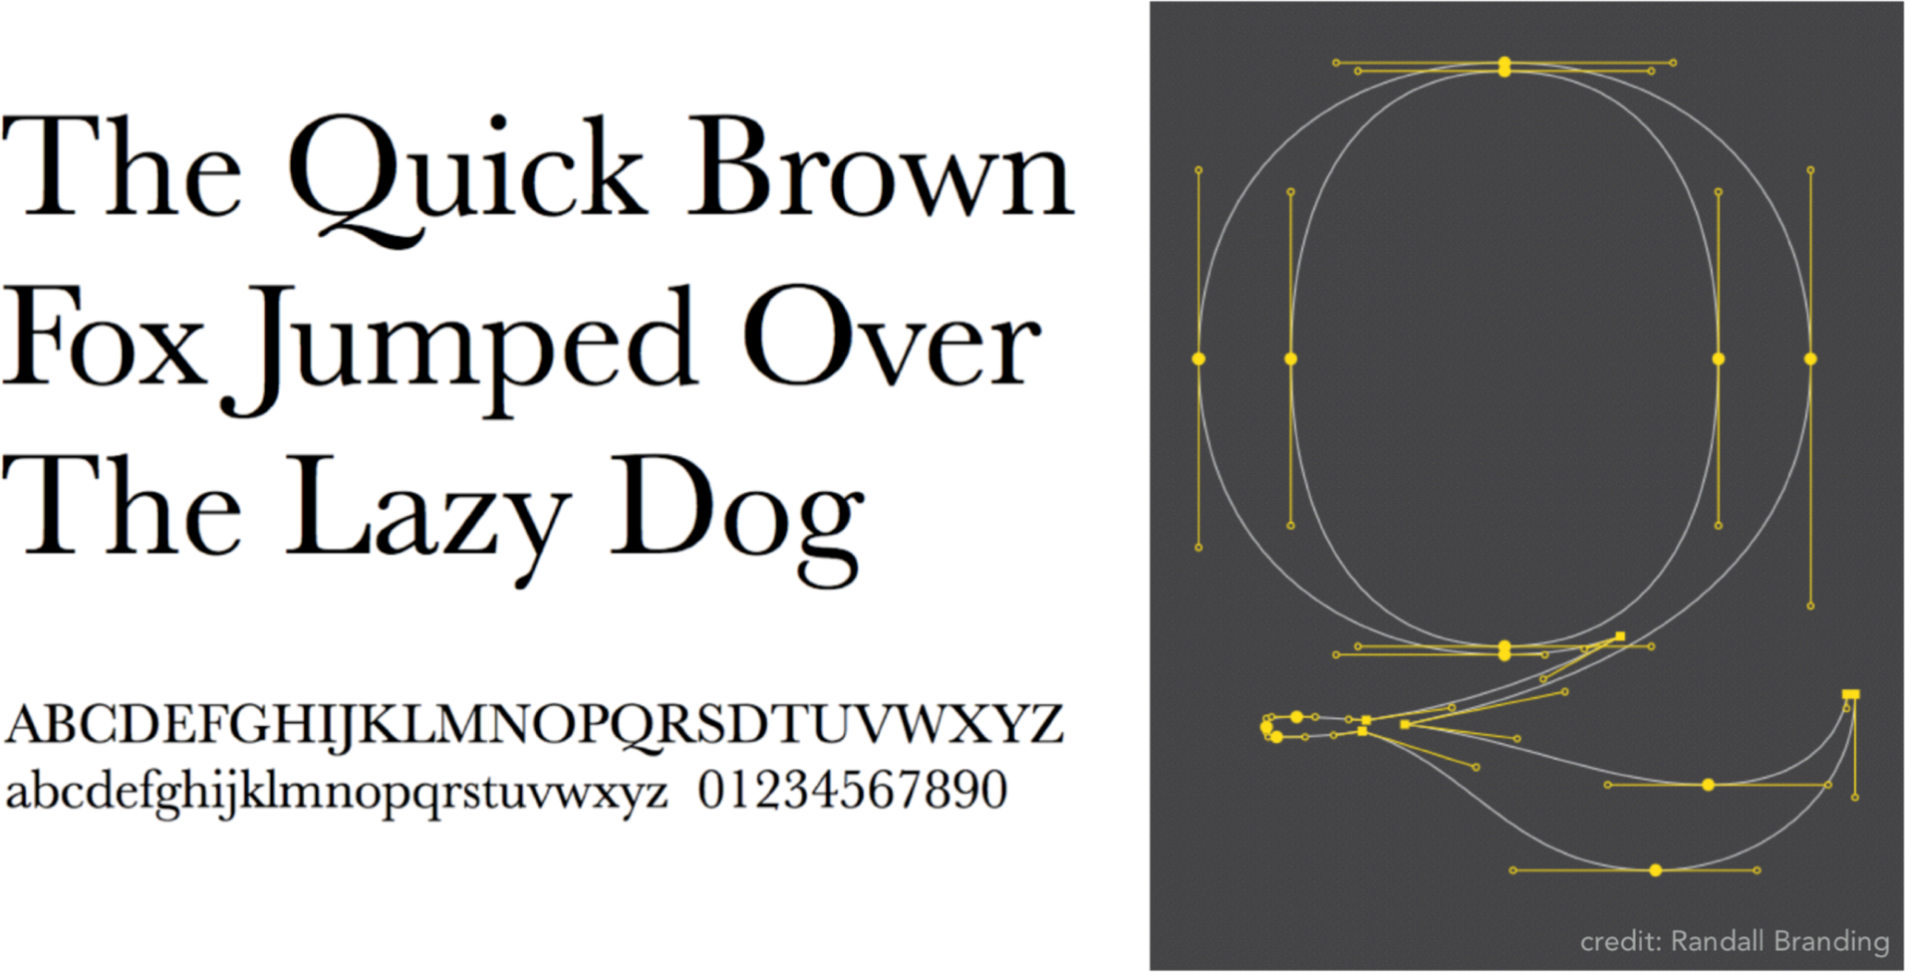
Typography
The Quick Brown Fox Jumps Over The Lazy Dog
The font Baskerville

Slide 46
Why Study Computer Graphics?
Fundamental Intellectual Challenges
Creates and interacts with realistic virtual world
Requires understanding of all aspects of physical world
New computing methods, displays, technologies

Slide 47
Why Study Computer Graphics?
Technical Challenges
Math of (perspective) projections, curves, surfaces
Physics of lighting and shading
Representing / operating shapes in 3D
Animation / simulation

Slide 48
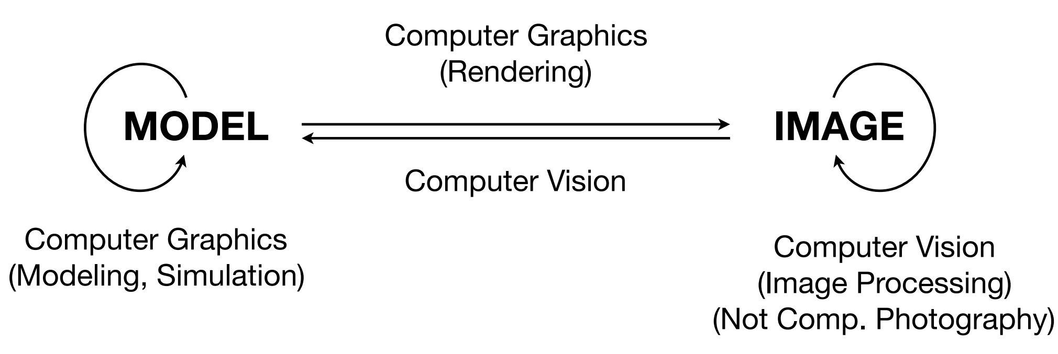
Computer Graphics vs. Computer Vision

Slide 49
Thank you!

